Slide 1

StyleSense
Yash Baviskar(22107021)
Mohini Deore (22107065)
Akshata Khandekar (22107034)
Computer Science and Engineering
( Data Science )
Project Guide
Ms. Ujwala Pagare
Notes:
‹#›

Slide 2
Outline
Introduction
Literature Survey of the existing systems
Limitations of the existing systems
Problem statement
System Design
Technologies and methodologies
Implementation
Conclusion
References
Notes:
‹#›

Slide 3
Introduction
StyleSense is an innovative platform that provides personalized outfit recommendations and advanced analytics for fashion inventory management.
Designed for both individuals and businesses, it combines machine learning techniques to deliver tailored styling suggestions and insightful data analysis
. The platform aims to streamline wardrobe management and empower fashion businesses with data-driven decision-making tools.
Notes:
‹#›

Slide 4
Motivation
Simplify the process of selecting stylish outfits by providing personalized, data-driven recommendations
Help fashion businesses optimize inventory management and gain insights from customer purchasing behaviors.
Bridge the gap between fashion and technology by integrating machine learning for enhanced decision-making.

Slide 5
Objectives
Recommending outfits based on their uploads and saves by Clustering
Allow users to save images of fashion items in their profile and inventory, using these saved items to generate tailored outfit recommendations that match their preferences and wardrobe.
Implement pandas and NumPy to offer advanced analytics for fashion businesses, allowing them to visualize trends, monitor sales, and optimize stock levels efficiently.
Identify frequent itemsets and products often bought together to enable fashion businesses to create effective bundling strategies, improving cross-sell opportunities using apriori algorithm.

Slide 6
Literature Survey of the existing system
SR NO | Title | Author | Year | Outcomes | Methodology
[1] | Multi-label Image Classification Based on VGG16 Network (IEEE): | W. Zhang, X. Yang | 2022 | Enhanced multi-label classification accuracy for complex image datasets. | Applied VGG16 for multi-label classification of images, optimizing it through adjustments in layer architecture.
[2] | Categorical Image Classification Based on ResNet (IEEE): | A. Mahajan, S. Chaudhary | 2019 | Achieved high classification accuracy by leveraging deep residual learning. | Deep learning using ResNet architecture for efficient categorical image classification.
Notes:
‹#›

Slide 7
Literature Survey of the existing system
SR NO | Title | Author | Year | Outcomes | Methodology
[3] | Weight Based KNN Recommender System (IEEE): | E. Elsayed, A. Alquhtani | 2013 | Increased accuracy and recommendation quality compared to standard KNN approaches. | Weighted KNN algorithm that improves upon traditional KNN by assigning different weights based on item similarity.
[4] | Fashion Image Classification Using CNN-VGG16 (SpringerLink): | K. Das, S. Roy | 2023 | Utilized VGG16 with pre-trained weights to classify fashion images using deep convolutional networks. | Achieved improved classification performance by utilizing transfer learning with the VGG16 model.
Notes:
‹#›

Slide 8
Limitations of existing systems
Companies with their own image datasets cannot efficiently scale their recommendation systems using existing models, limiting their utility in real-world applications.
Recommendation systems like content-based and cosine similarity require accurate, well-labeled metadata, and without it, they struggle with ineffective and irrelevant outfit recommendations, making scaling difficult in large datasets.
High Computational Cost and Integration Challenges
Notes:
‹#›

Slide 9
Problem statement
Individuals and fashion businesses struggle with efficient wardrobe management, inventory optimization, and personalized recommendations, creating a need for an intelligent, data-driven solution to streamline these processes based on user-uploaded images.

Slide 10
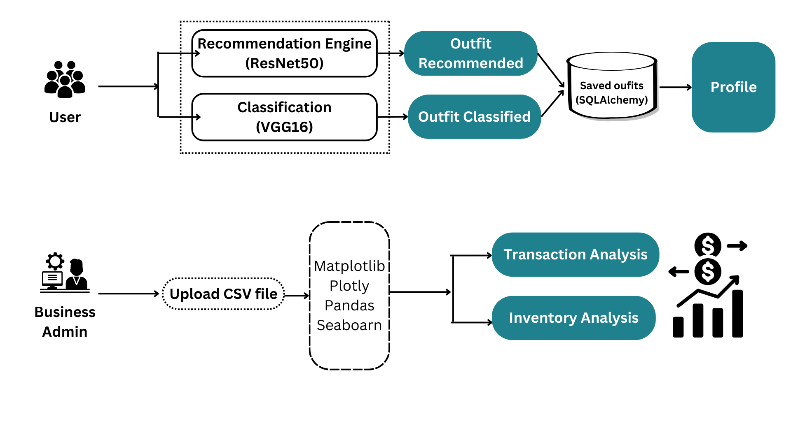
System Design
Notes:
‹#›

Slide 11
Technologies and methodologies
Frontend Technologies:
HTML/CSS: Used for the structure and styling of the user interface.
JavaScript: Implements interactivity and dynamic content loading.
Plotly and Matplotlib: Employed for data visualization to enhance user insights.
Backend Technologies:
Flask: Serves as the web framework for developing the application.
SQLAlchemy: Facilitates database interactions and ORM capabilities.
Pandas: Utilized for data manipulation and analysis tasks.
Machine Learning Model:
VGG16 Model: Applied for image classification to enhance recommendation accuracy.
Notes:
‹#›

Slide 12
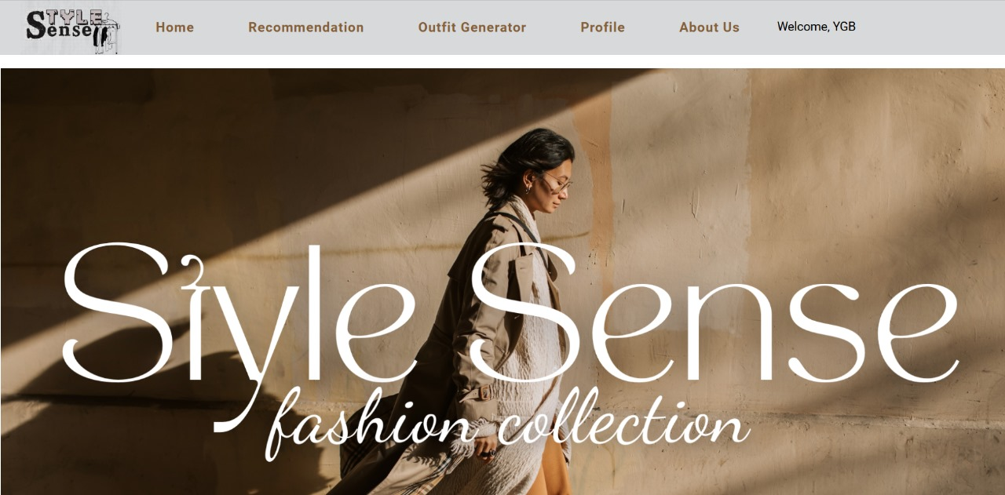
Implementation

Slide 13
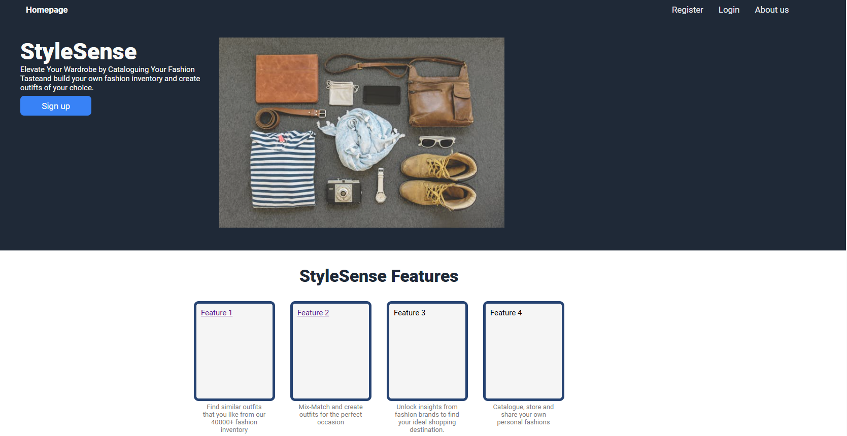
Notes:
‹#›

Slide 14
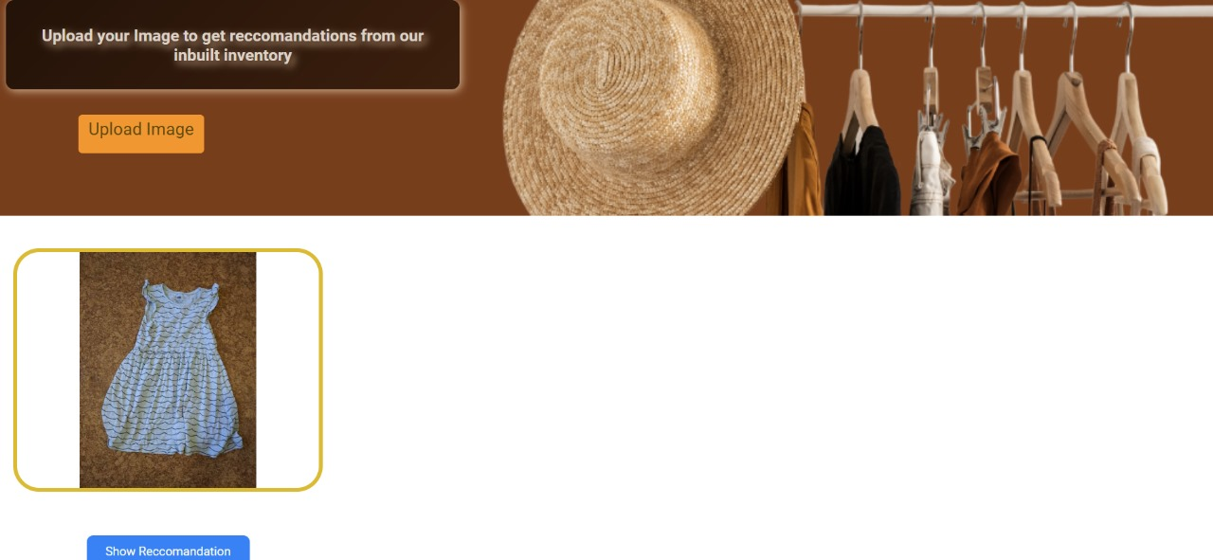

Slide 15
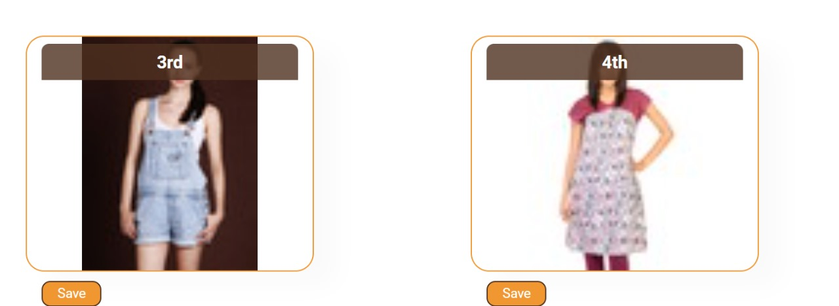

Slide 16
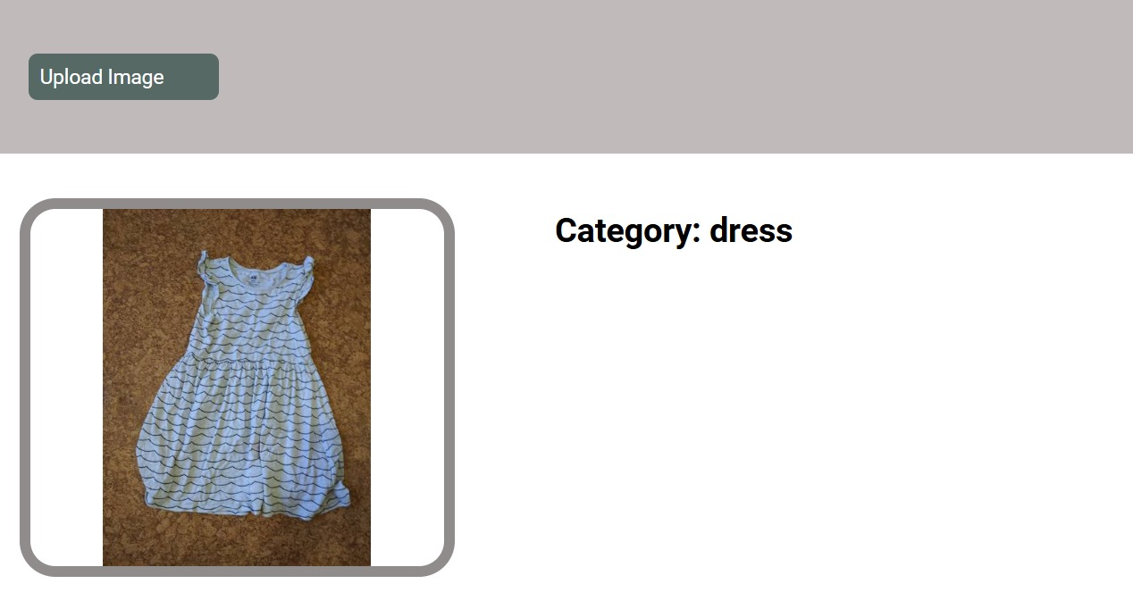

Slide 17
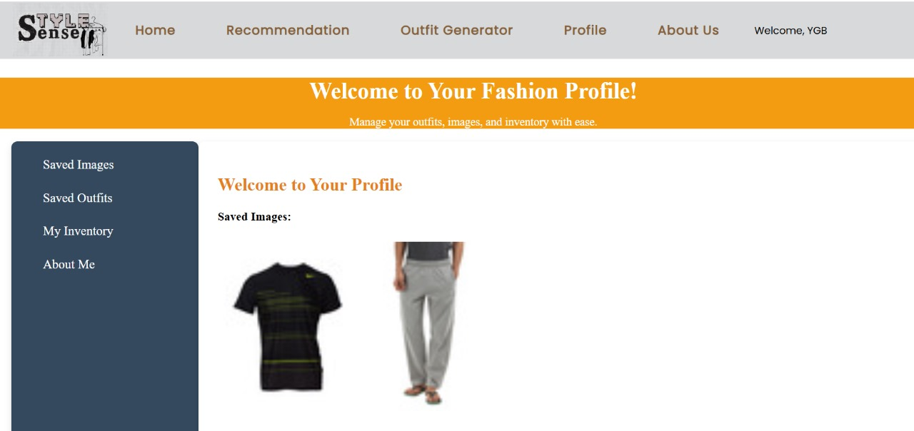

Slide 18
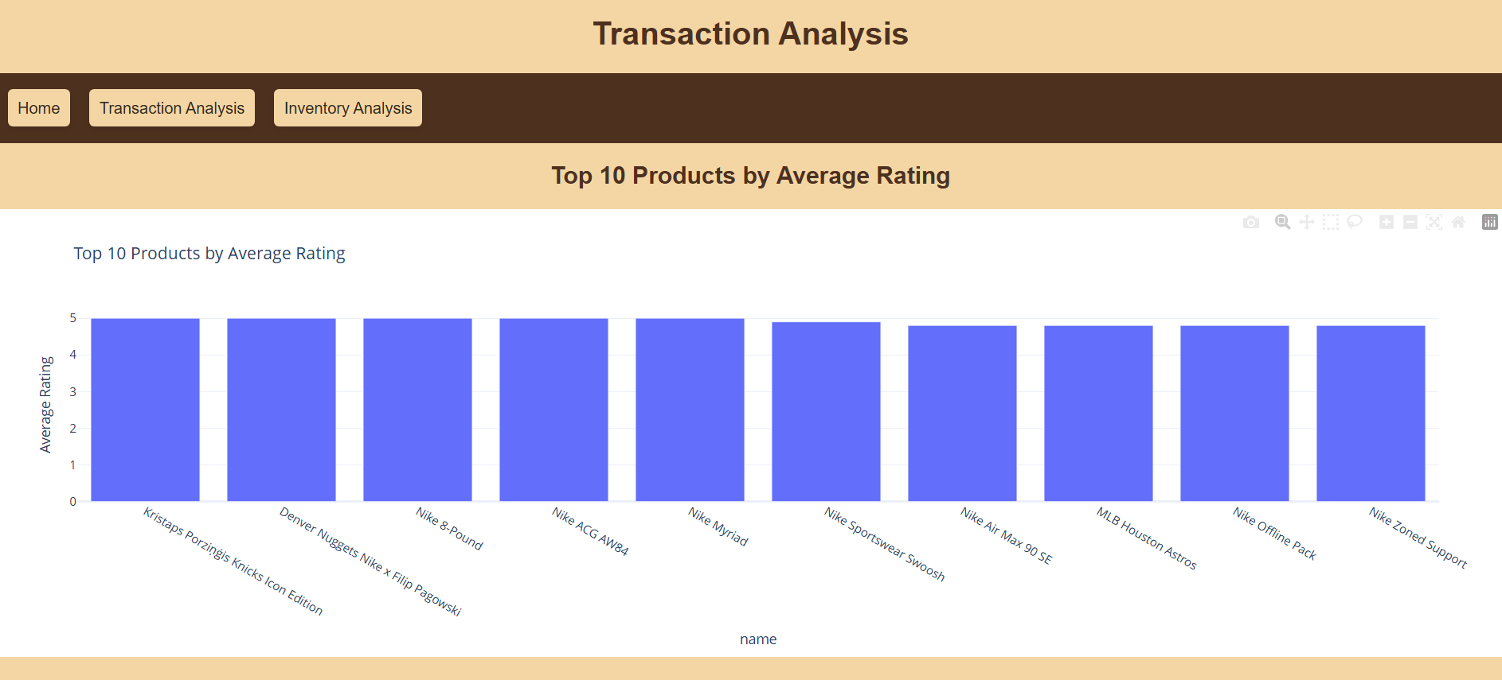

Slide 19
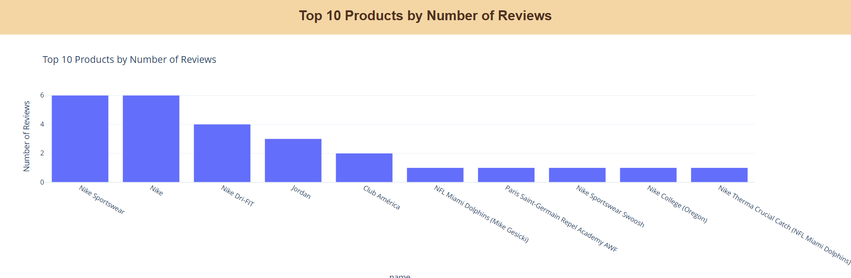

Slide 20
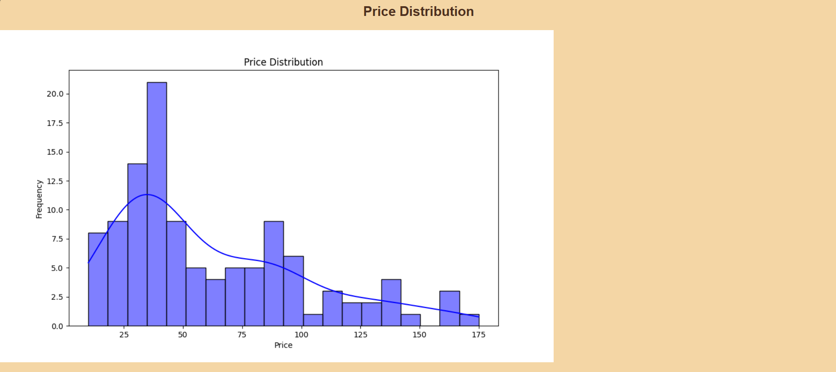

Slide 21
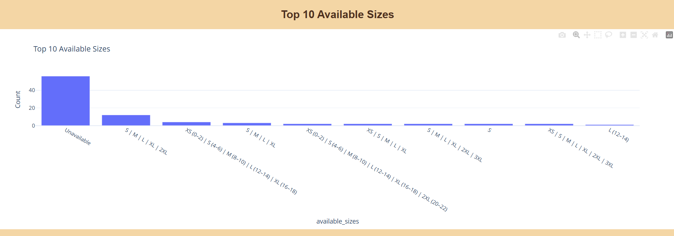

Slide 22
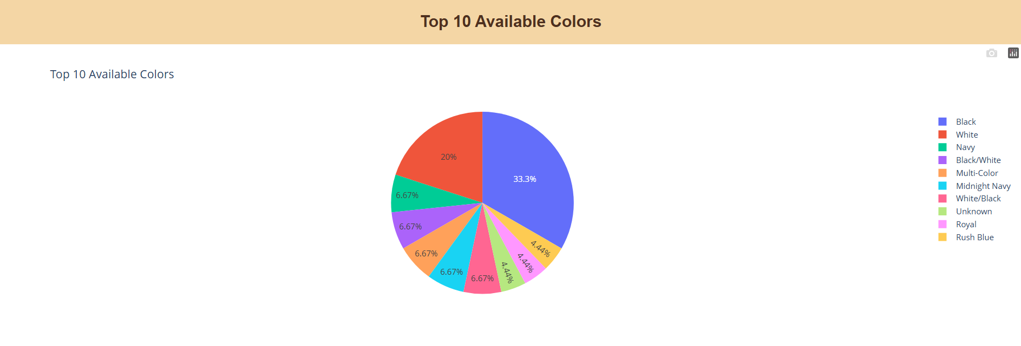

Slide 23
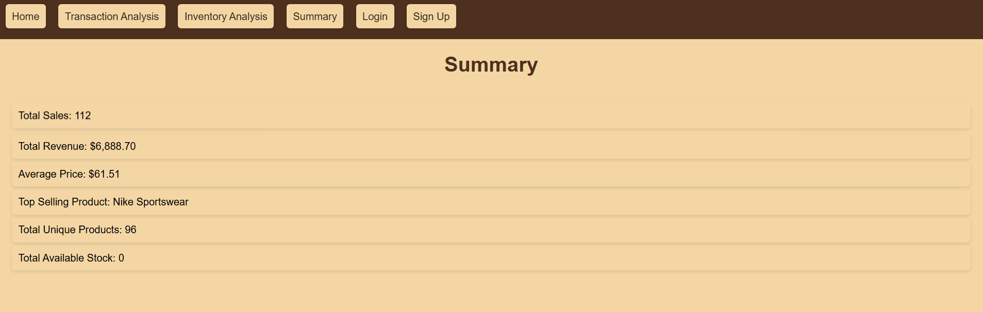

Slide 24
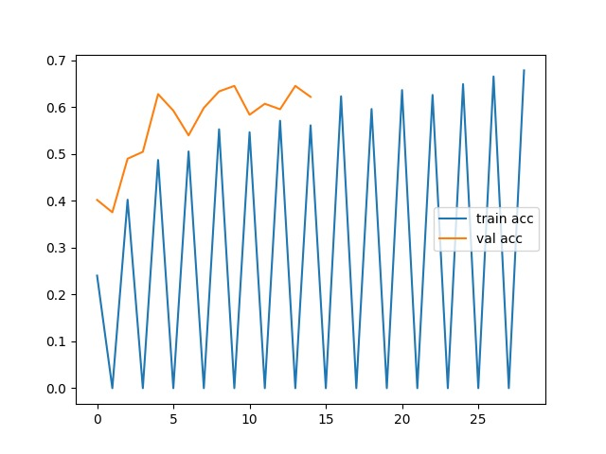
Result
VGG16 - Used

Slide 25
MobileNet

Slide 26
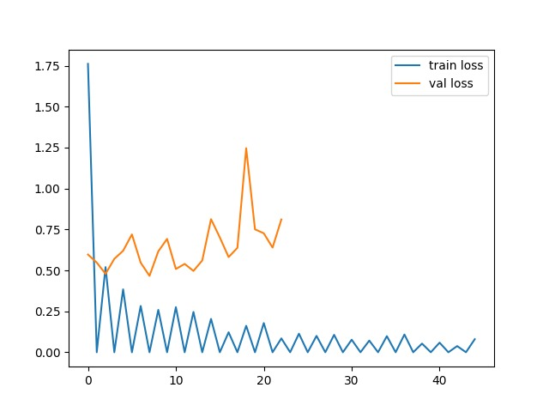
VGG16

Slide 27
Conclusion
The StyleSense web application effectively combines advanced machine learning techniques with user-friendly design to enhance wardrobe management and provide personalized outfit recommendations
Notes:
‹#›

Slide 28
References
[1] W. Yi, S. Ma, H. Zhang and B. Ma, "Classification and improvement of multi label image based on vgg16 network," 2022 3rd International Conference on Information Science, Parallel and Distributed Systems (ISPDS), Guangzhou, China, 2022W. IEEE
[2 ]A. Mahajan, S. Chaudha)W. Yi, S. Ma, H. Zhang and B. Ma, "Classification and improvement of multi label image based on vgg16 network," 2022 3rd International Conference on Information Science, Parallel and Distributed Systems (ISPDS), Guangzhou, China, 2022ry,Categorical Image Classification Based on ResNet (IEEE) 2019
[3] B. Wang, Q. Liao and C. Zhang, "Weight Based KNN Recommender System," 2013 5th International Conference on Intelligent Human-Machine Systems and Cybernetics, Hangzhou, China, 2013 Volume 2,IEEE
[4] K Das, T., Aznag, K., El Orrak, A. (2023). Fashion Image Classification Using Convolutional Neural Network-VGG16 and eXtreme Gradient Boosting Classifier 10 June 2023
Notes:
‹#›

Slide 29
Thank You...!!
Notes:
‹#›

